Slide 1
Online News Popularity
Group 15
Anindita Mitra, Anisha Vijayan, Murtaza Agha, Yu Ting Sun

Slide 2
Contents
Introduction
Dataset
Exploratory Data Analysis
Model Design and Evaluation Results
Supervised Models and Evaluation
Naive Bayes (Baseline)
Logistic Regression
KNN
SVM
Unsupervised model - PCA
Model Selection (Cost Matrix)
Conclusion

Slide 3
Introduction
Problem Statement
The dataset is about articles published by Mashable in a period of two years.
The Mashable team wants to identify articles which will become popular based on the historical data.
The team wants to identify and set the right price for advertisements based on their popularity.
Project Goal
The goal is to predict if the article is among the most popular ones based on sharing in social networks.
We decided to find the best predictive model in the dataset by data engineering and utilizing Machine Learning algorithms to achieve the goal.

Slide 4
Dataset
Examples: 39700
Features: 61 (58 predictive attributes, 2 non-predictive, 1 goal field)
Target Variable: Number of Shares : > 1400 =popular & < 1400 = not popular
Source: UCI Data Repository
Goal: To find articles which will become popular using supervised learning techniques taught in class.

Slide 5
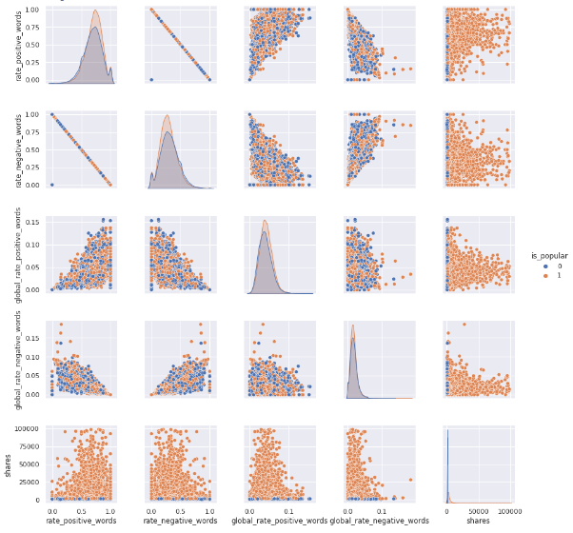
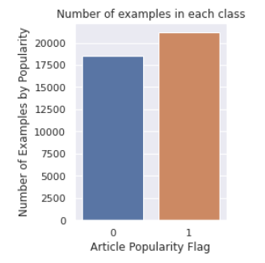
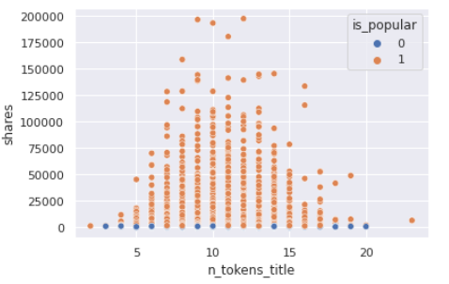
Exploratory Data Analysis
Balanced dataset
50% quantile value = 1,400
Shares >= 1,400 - Popular (class 1)
Shares < 1,400 - Unpopular (class 0)
Clean data
Relationships between variables - heatmap, histogram, scatterplot and pair plots
1181 examples with no words in the content
Popular articles were posted usually on the weekdays rather than the weekends.
Social media and Technology articles were more popular than others

Slide 6
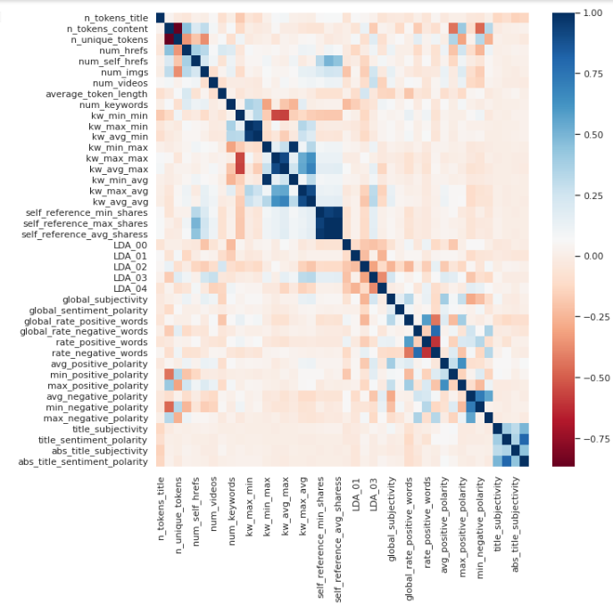
Exploratory Data Analysis
Feature Engineering
Based on Correlation Matrix, we removed highly correlated attributes, such as Self Reference Average Shares, Average Negative Polarity, and Average Positive Polarity.
Based on Chi-square tests, we have dropped unimportant features such as Weekday Is Saturday and Weekday Is Sunday as these features are already covered in the Is Weekend feature.
50 features as our final predictor variables.

Slide 7
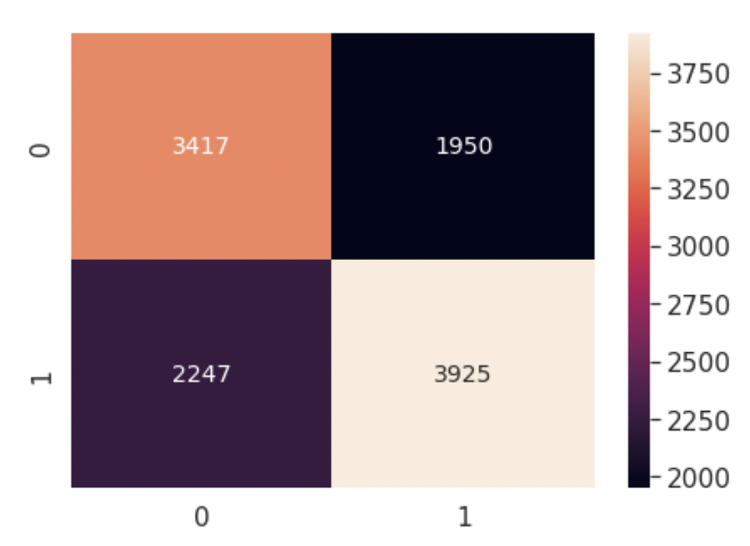
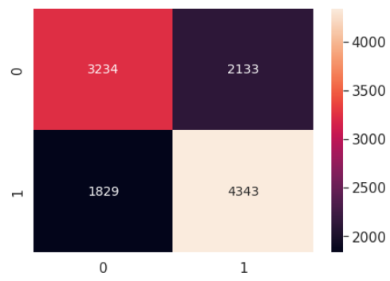
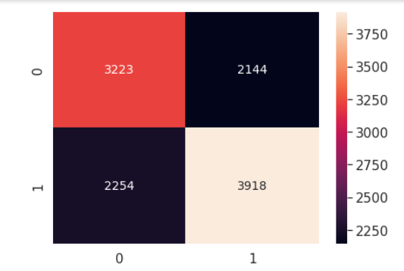
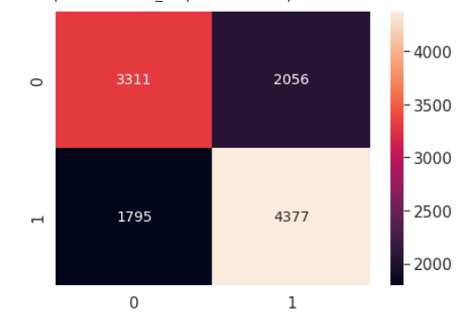
Supervised Models and Evaluation
Naive Bayes
Accuracy : 64%
AUC: 64%
F1 Score: 65%
Logistic Regression
Accuracy : 65%
AUC: 65%
F1 Score: 68%
KNN
Accuracy : 62%
AUC: 62%
F1 Score: 64%
SVM
Accuracy : 67%
AUC: 66%
F1 Score: 69%

Slide 8
Unsupervised Model - PCA
PCA is a dimensionality reduction technique that transforms a set of features in a dataset into a smaller number of features while at the same time trying to retain as much information in the original dataset as possible
The new variables produced by PCA are linear combinations of the initial variables which have no correlation and no information is redundant.
Started with 50 features in our dataset after eliminating features during EDA.
We considered two cases :
Case 1: when all components are kept .
Case 2: find desired components to explain 85% of variance.
Using case 1, the no. of components required to explain 95% of variance is 50 (still high).

Slide 9
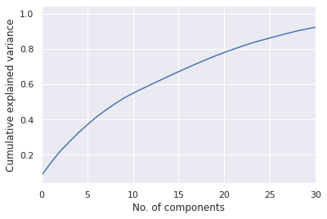
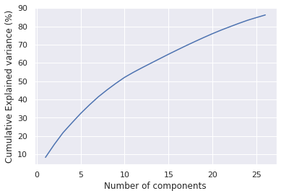
Unsupervised Model - PCA
Case 1: when all components are kept
Case 2: number of components for 85% explained variance
With the 50 features reduced to 26 no. of components that explains 85% of variance, we accuracy dipped to 64% for logistic regression.
Usage of PCA would not not be ideal for this dataset.

Slide 10
Cost Matrix
Correctly classifying popular articles will help Mashable to increase their revenue by setting the appropriate price at which the advertisements are sold to other social media platforms. (TP)
By correctly classifying unpopular articles, Mashable can reduce the number of such advertisements altogether and set lower costs for them. (TN)
When a popular article is misclassified as unpopular one, then it could incur a loss as the ads will be sold at a lower cost. (FN)
When an unpopular article is misclassified as popular one, then it would not be sold much and might even lose out on potential future ads. (FP)
Cost Matrix | 0 | 1
0 | $100 | ($50)
1 | ($200) | $300
Notes:
Cost matrix is similar to the confusion matrix except the fact that we are calculating the cost of wrong prediction or right prediction. It influences the decision making of a model. Helps minimize the costly misclassifications. Also maximize beneficial accurate classifications.

Slide 11
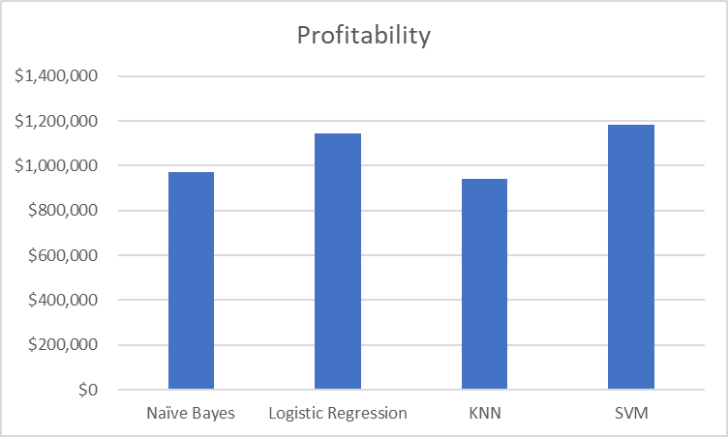
Cost Matrix
Cost Matrix | 0 | 1
0 | $100 | ($50)
1 | ($200) | $300
Naïve Bayes | 0 | 1
0 | $341,700 | ($97,500)
1 | ($449,400) | $1,177,500
Logistic Regression | 0 | 1
0 | $323,400 | ($106,650)
1 | ($365,800) | $1,293,900
KNN | 0 | 1
0 | $322,300 | ($107,200)
1 | ($450,800) | $1,175,400
SVM | 0 | 1
0 | $331,100 | ($102,800)
1 | ($359,000) | $1,313,100
Model | Profitability
Naïve Bayes | $972,300
Logistic Regression | $1,144,850
KNN | $939,700
SVM | $1,182,400
Profitability by Cost matrix shows highest profit from SVM model.
These values are based on the test data.
Accuracy isn’t the only way to pick a model

Slide 12


Conclusion
SVM model gives us the highest accuracy as well as the highest profitability
SVM correctly predicts the most popular and least popular articles
Further scope and learnings:
Regression or Ensemble models could give us better results ?
Also, it depends on the medium through which the article is shared. For example, if the article is shared by a celebrity on instagram or twitter, it would gain more popularity.
This could be a new feature that could be added to improve the models efficiency
Accuracy is not always the correct measure to evaluate a model
The maximum accuracy obtained as per the paper is 67% with 0.73 AUC for the Random Forest model. ( close to our SVM)
Most popular or most shared article that was posted by Mashable.
Unpopular or least shared article that was posted by Mashable.

